Slide 1
Syllabus and Introduction
CSC 101 – Introduction to Computer Science
Lecture 00
Department of
Computer Science and Engineering,
Independent University, Bangladesh

Slide 2
Instructor Info
M Ashraful Amin, PhD
Academic Block: 6003-B
aminmdashraful@gmail.com
www.cvcrbd.org
Office Hours: ST 1120~1500
(or any other time with appointment)
Teaching Assistant Name: TBA
Teaching Assistant Office Hours: TBA
Notes:
Ask about netID
Visit web page

Slide 3
Course Web Page
www.piazza.com

Slide 4

Text
Starting out with C++: From
Control Structures through
Objects, 7th Edition
Tony Gaddis
won’t cover the entire book

Slide 5
Prerequisites
High School Algebra
Basic logical and analytical ability
Notes:
No programming experience or cs course required

Slide 6
Academic Honesty
Need to be very careful, especially in CSC
    Plagiarism of ‘code’
    Collusion - friends are good but not sharing of code is not
Do NOT google for solutions!
Do NOT post solutions on your wall/blog/webpage during the course
Do NOT post solutions on piazza course webpage
Pair and Team Programming
  Work in pairs BUT do not submit the same code
  It’s fun! (usually)
  Discuss the issues to solve the problems, help others
Notes:
Choosing partners

Slide 7
Other Policies
Withdrawal Policy
  Independent University, Bangladesh regulations
    Withdraw within first week after midterm
Attendance Policy
  Come to class!- you might miss the Quizzes they are unannounced and every week. 10% marks is assigned to class attendance
Makeup Policy
  No make-up exam will be taken unless reasonable emergency

Slide 8
Course Goals
What’s your goal?
  Need it for CSC/CEN/CSE major
  Need it for other Engineering major
  Anything else!!!!-visit www.cvcrbd.org

Slide 9
Course Goals
Learn to develop algorithms to solve problems
  Improve analytical and problem solving skills
  Develop sound logical reasoning
Learn to implement algorithms in C++ (or some other high-level language)
  Implementations should be correct and have good style!
  Won’t deal much with efficiency in this class, although that’s also very important

Slide 10
(Auxiliary) Course Goals
Find out more about what is computer science and what it is that computer scientists do
Understand a little bit about how a computer works
Communicate better
  Understand the jargon
  Technical communication

Slide 11
What is Computer Science?
Computer science is the study of the theoretical foundations of information and computation and their implementation and application in computer systems
      Source: wikipedia
What does that mean really?

Slide 12


Identify a problem and follow a systematic method
to solve it using a computer
What goes on in between?

Slide 13
design
program
Algorithm
High-level
languages
Problem statement
compile
Circuits
Micro-
architecture
Instruction
Set
Architecture
design new machines

Slide 14
What do Computer Scientists do?
Develop algorithms
  Analysis of algorithms
Design new machines
  Organization, architecture
Make programs run faster and more maintainable
  Compilers and Software Engineering
Do a lot of math and theory
    Logic, discrete, graph theory, formal language theory and theory of computation
Artificial Inelegancy
  Thinking machines, smart machines, strong machins

Slide 15




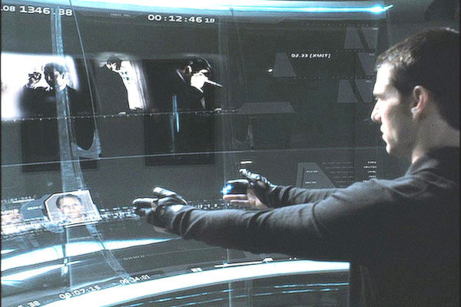
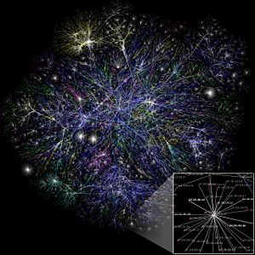

Slide 16

What Computer Scientist Don’t Do
Sit in a dark basement and program 18 hours a day!

Slide 17
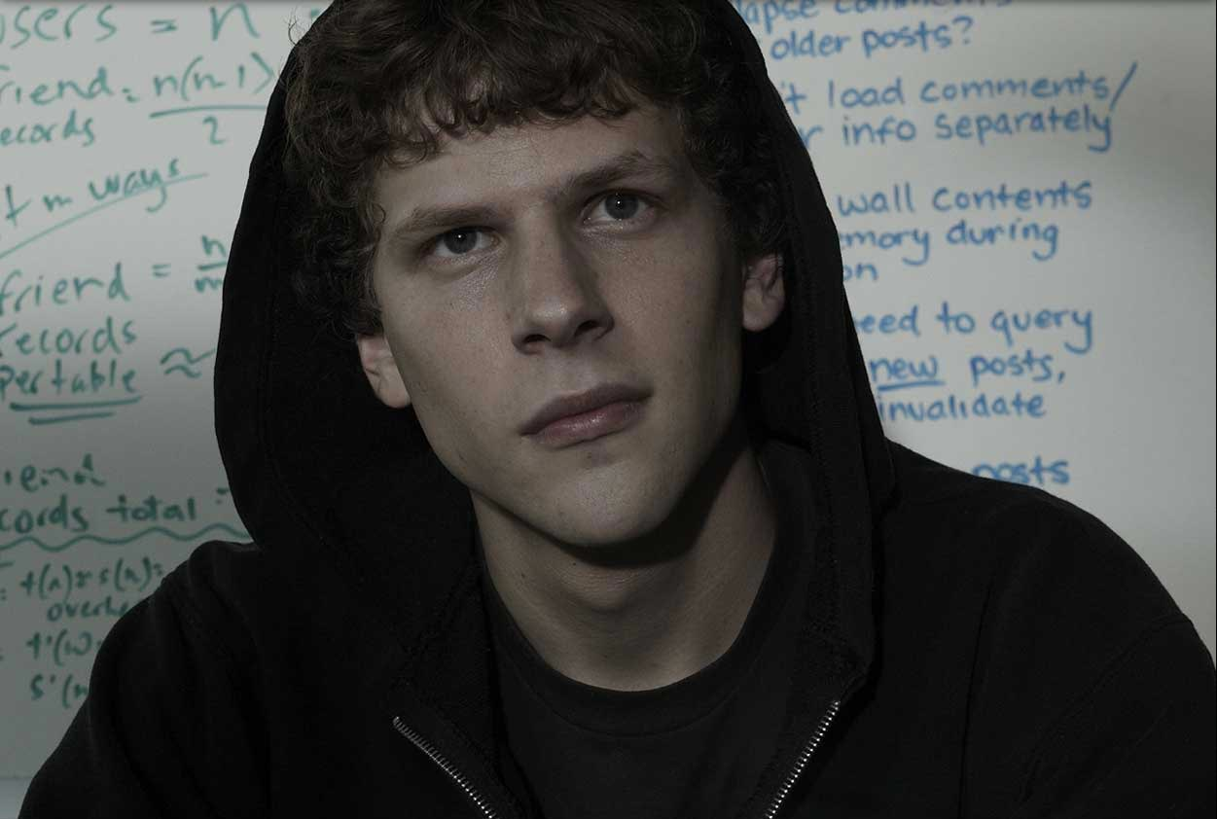
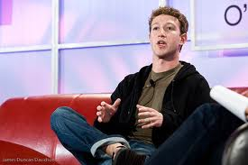
Computer Scientist or Not?
Mark Zuckerberg
Founded Facebook
Went to Harvard

Slide 18

Computer Scientist or Not?
Sergey Brin (1973 - )
Co-founder of Google with Larry Page
Stanford Grad School

Slide 19
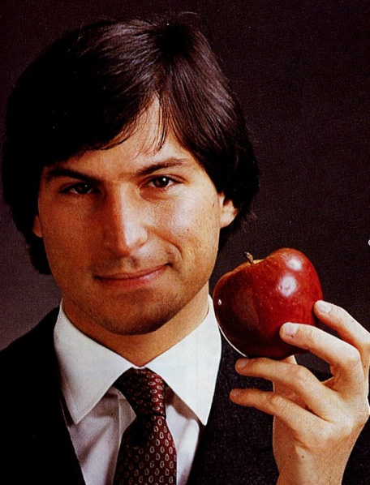
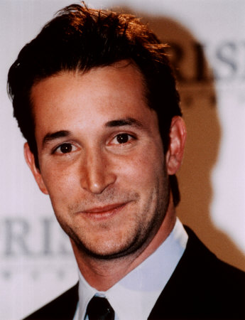
Computer Scientist or Not?

Slide 20
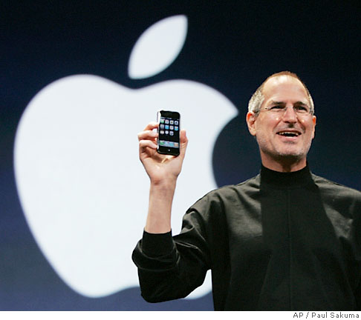
Computer Scientist or Not?
Steve Jobs (1955 - 2011)
Co-founder of Apple
CEO of Pixar
Main person behind
  GUI
  iPod
  iPhone
Rides a private jet

Slide 21
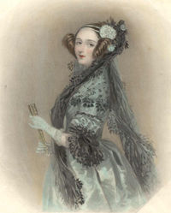
Computer Scientist or Not?
Ada Lovelace (1815-1852)
Married to Charles Babbage who invented the analytical machine
Daughter of Lord Byron
First Programmer

Slide 22
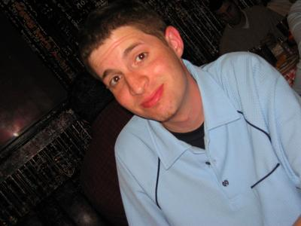
Computer Scientist or Not?
Random Guy

Slide 23
Know your course Web-page
classroom.google.com/
You need to open an account
You need to give me your email address (Now)
Preferably gmail, yahoo, or hotmail
Please check your email.
Lets do it in the class today.
What software you will need for your course !
Where to get it!

